Slide 1

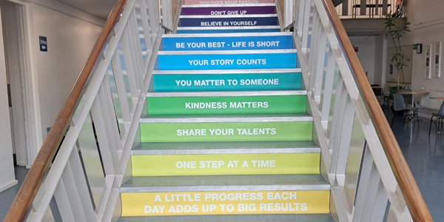
IT Induction

Slide 2

Generic Student Login for PCs and laptops
Username: 25NameSurname@colaisteide.ie
Password: to be provided by your teacher
Student wifi : gateway2020!

Slide 3






What we will cover today
Click on the each of the boxes to go straight there!
1
2
3
4
How to access our student support site myCampus.ie
Setting up your college Microsoft 365 account.
Creating folders in Microsoft OneDrive
Creating and naming a Microsoft Word document
Creating and sending an email in Microsoft Outlook
5
6
7
8
Creating and saving folders in Microsoft OneDrive
How to get your student card
Accessing Teams & Moodle
Free Courses
ICDL&AI
How to get your student card
How to access our student support Hub

Slide 4

1. Setting up your Microsoft 365 Account
When you are a registered student in FET Ide Finglas you will receive a username and password from the college to gain access to your Microsoft 365 account.
You will have access to all of the Microsoft 365 apps in this package.
Menu
Next

Slide 5
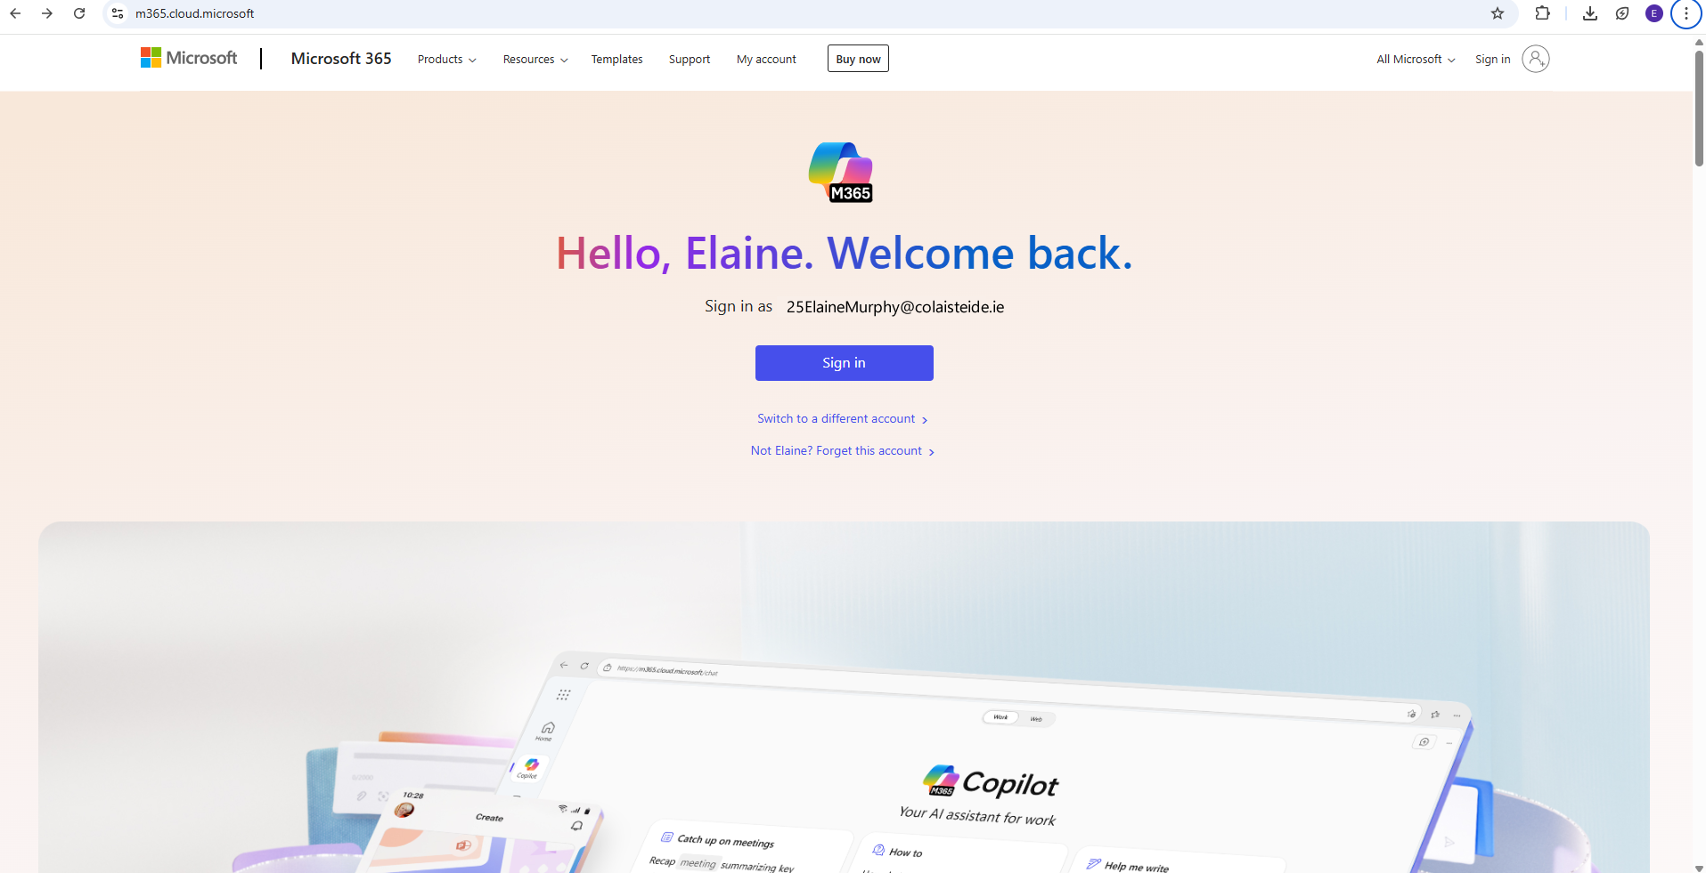


Step 1: Accessing your Microsoft 365 Account
1. Go to Microsoft365.com
2. Click on blue Sign In button
Menu
Next

Slide 6
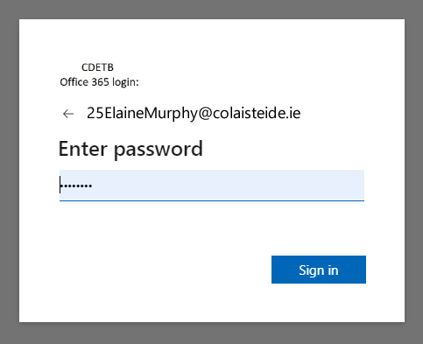

Step 2: Username & Password
2. Click on blue Sign In button
1. Enter your username & password
Menu
Next

Slide 7
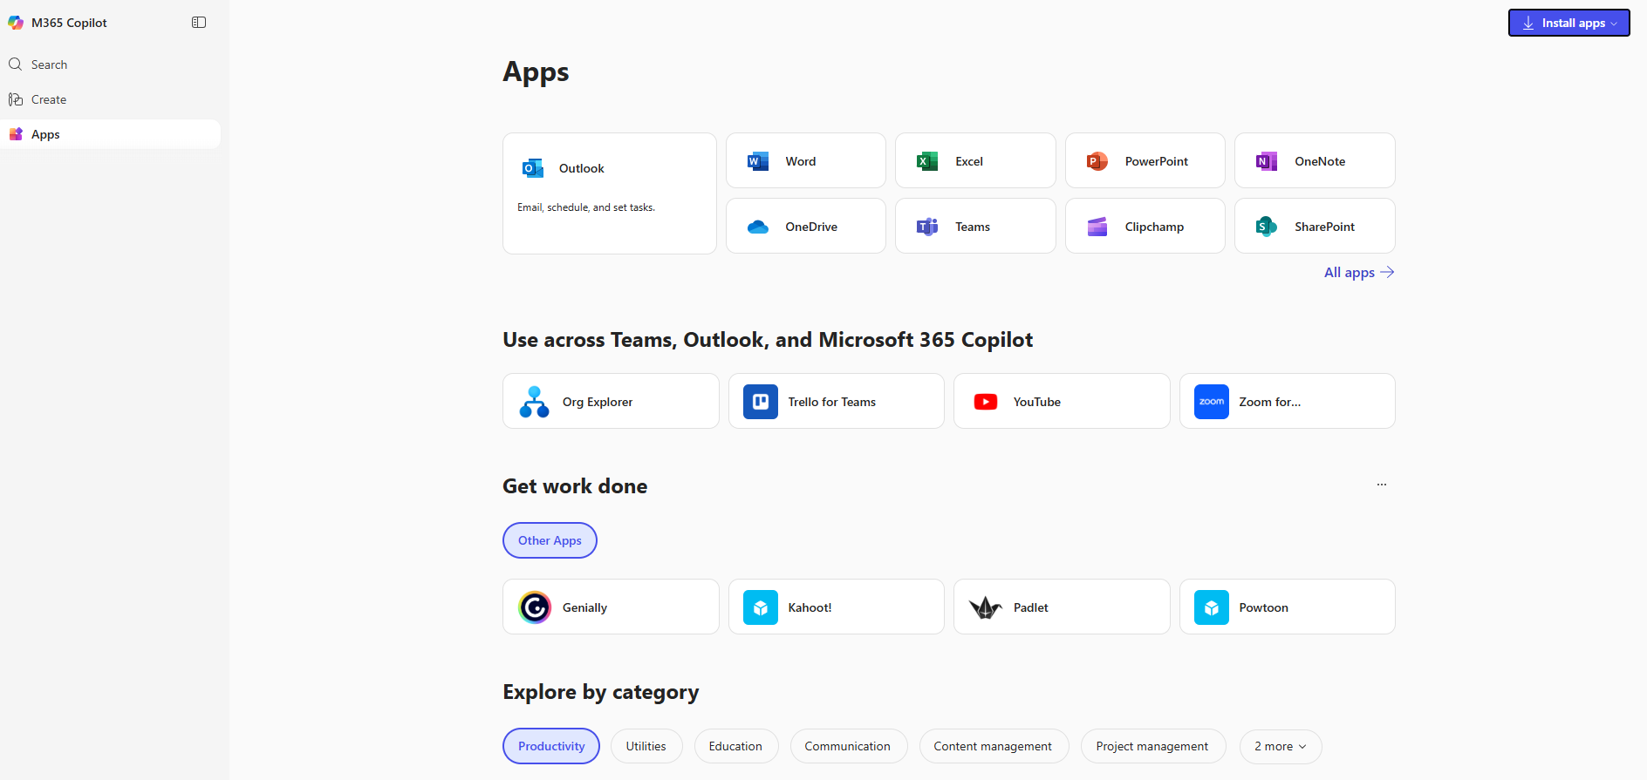
Step 3: Accessing Microsoft 365 Apps
You are now signed in and have access to all Microsoft 365 apps
Menu
Next

Slide 8

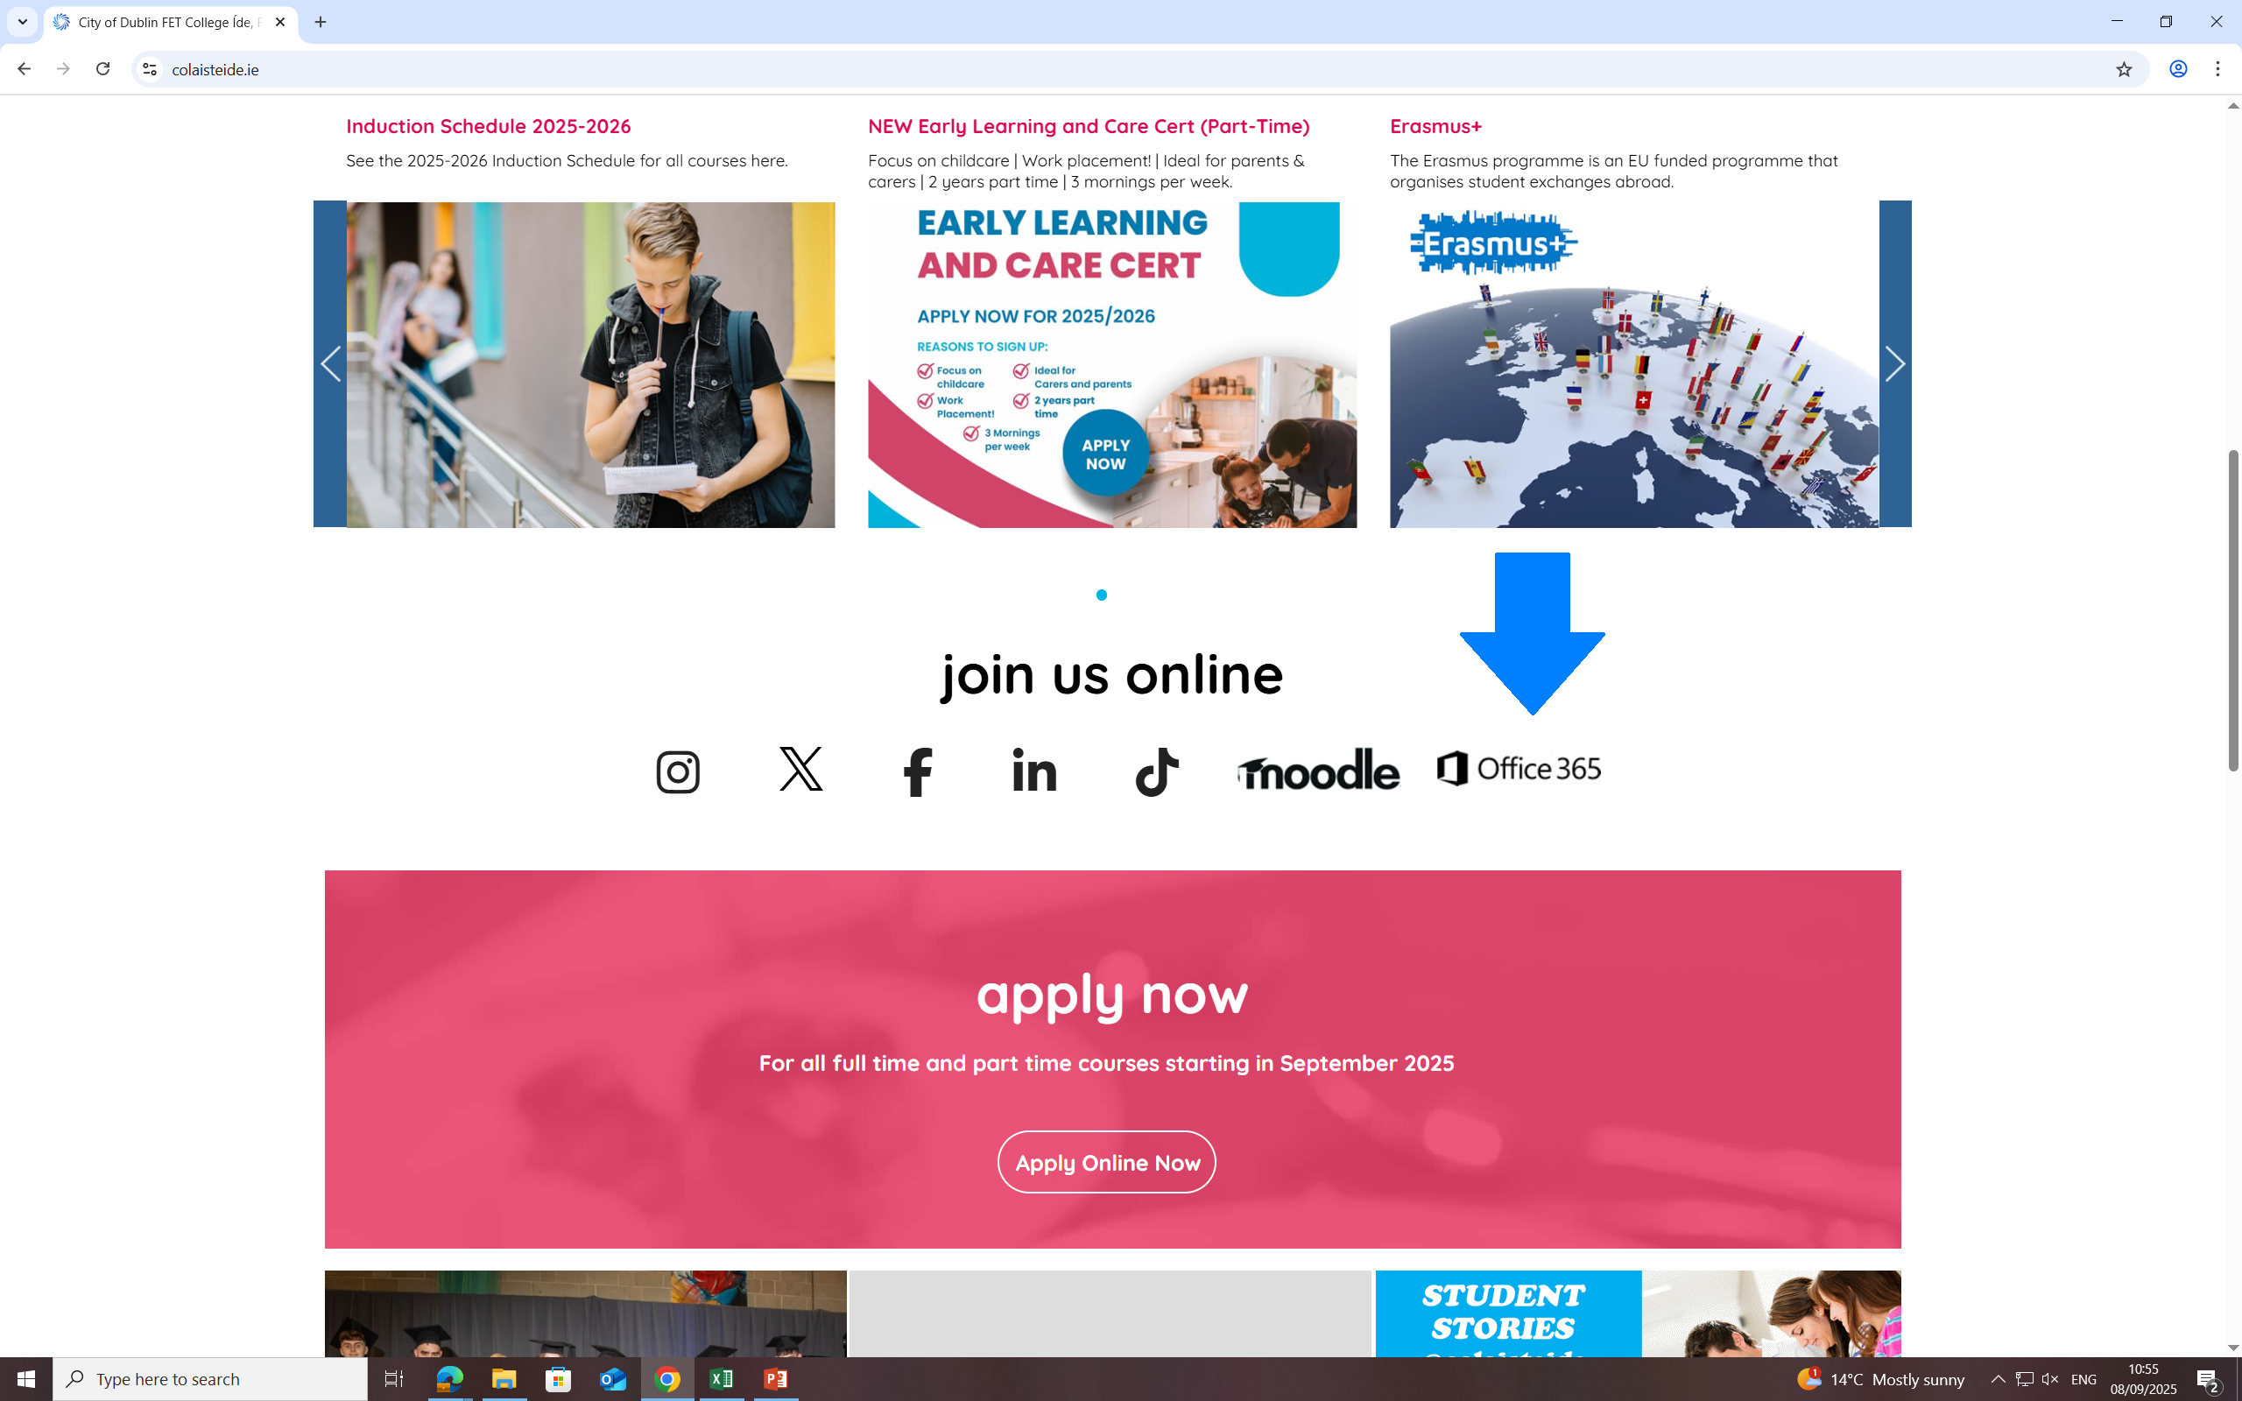
Activity 1: Log into 365
Log into your Microsoft 365 account using your college learner email and password.
Menu
Next

Slide 9
2. Creating folders in Microsoft OneDrive
Menu
Next

Slide 10

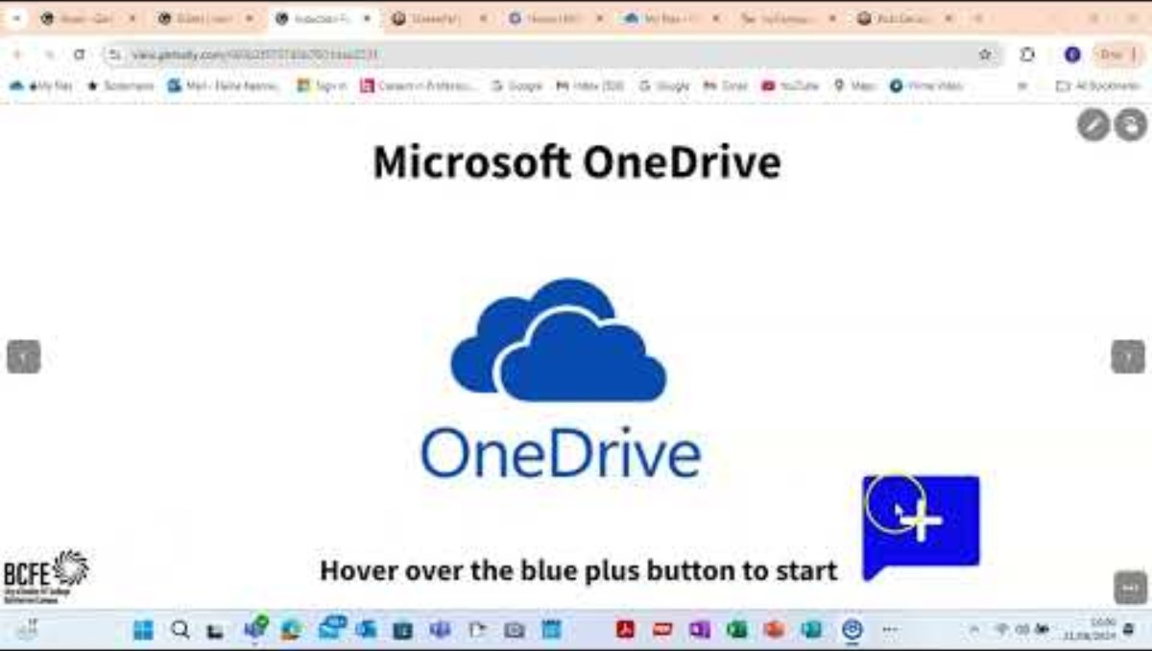
Activity 1: Create Folder
Create a folder in Microsoft OneDrive.
Name this folder Induction 2025.
Menu
Next

Slide 11
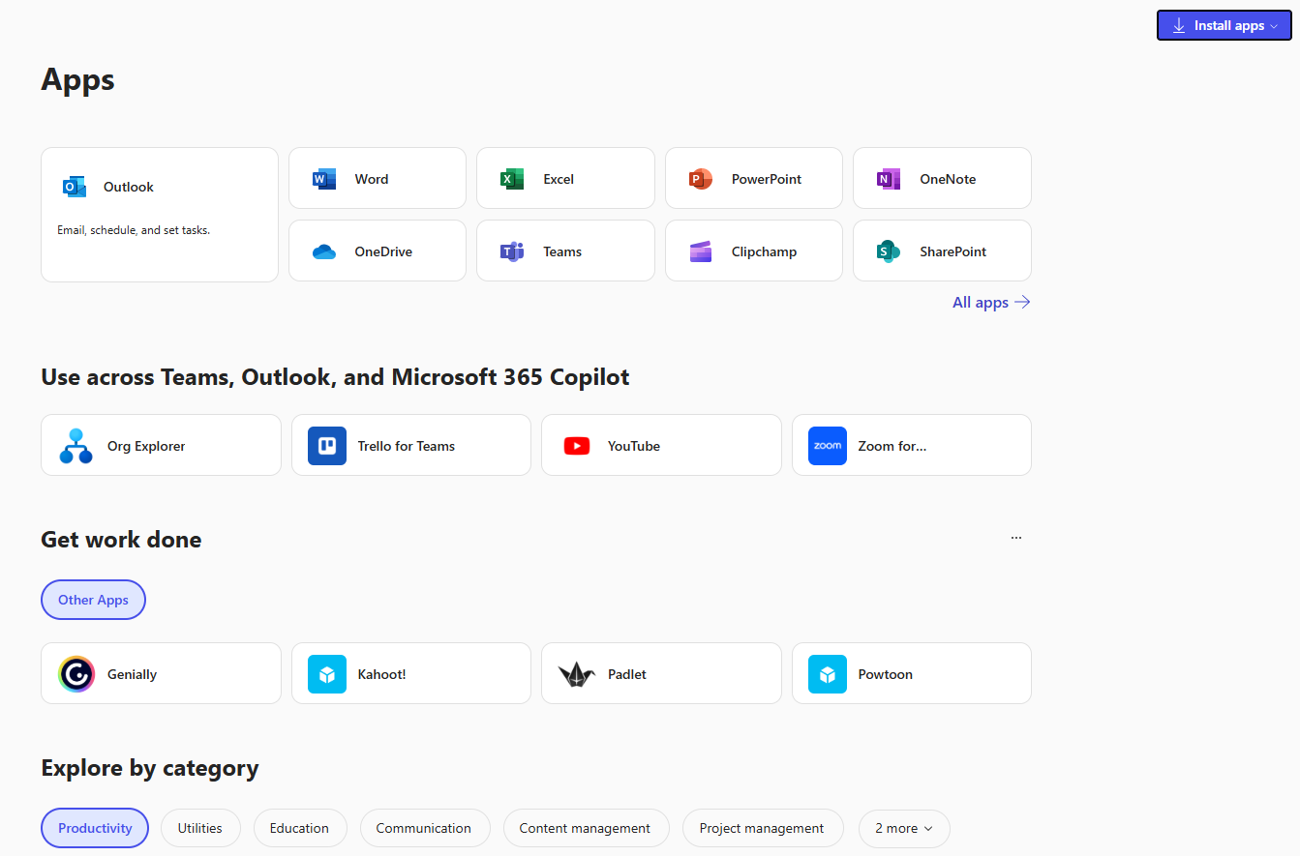
Step 2: Accessing OneDrive
Click on the OneDrive Icon
Menu
Next

Slide 12
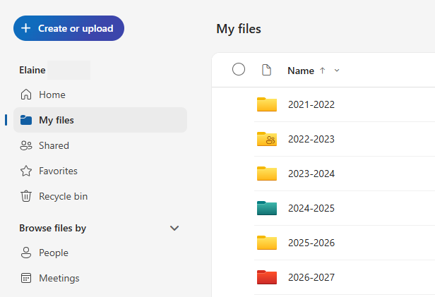
Step 2: Create a folder
Click on the Create or Upload button and choose Folder to add a new folder
Menu
Next

Slide 13
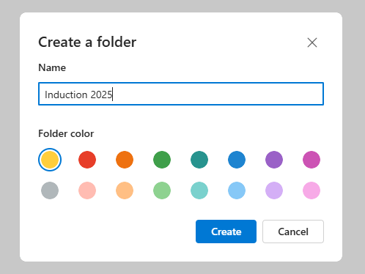
Step 3: Name your folder
Name your Folder
Click on blue Create button
Menu
Next

Slide 14
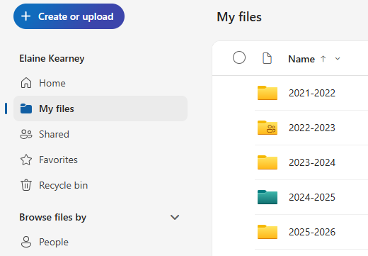
Step 4: View Files & Folders
Click on My files to view
files & folders
Menu
Next

Slide 15
3. Creating & Naming a Microsoft Word Document
Menu
Next

Slide 16

Step 1: Open Microsoft Word from your Apps Screen
Click on the Word Icon
Menu
Next

Slide 17
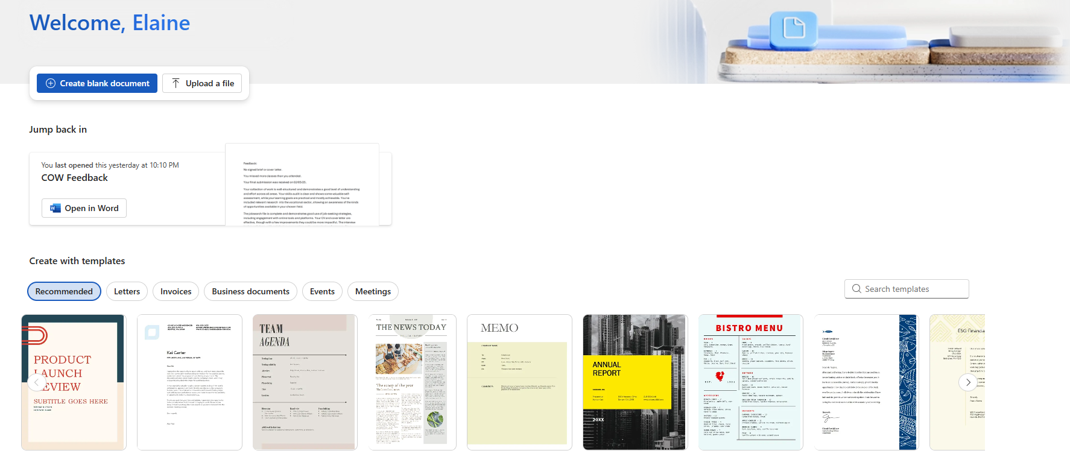
Step 2: Create a new document
Click on the Create Blank Document button
Menu
Next

Slide 18
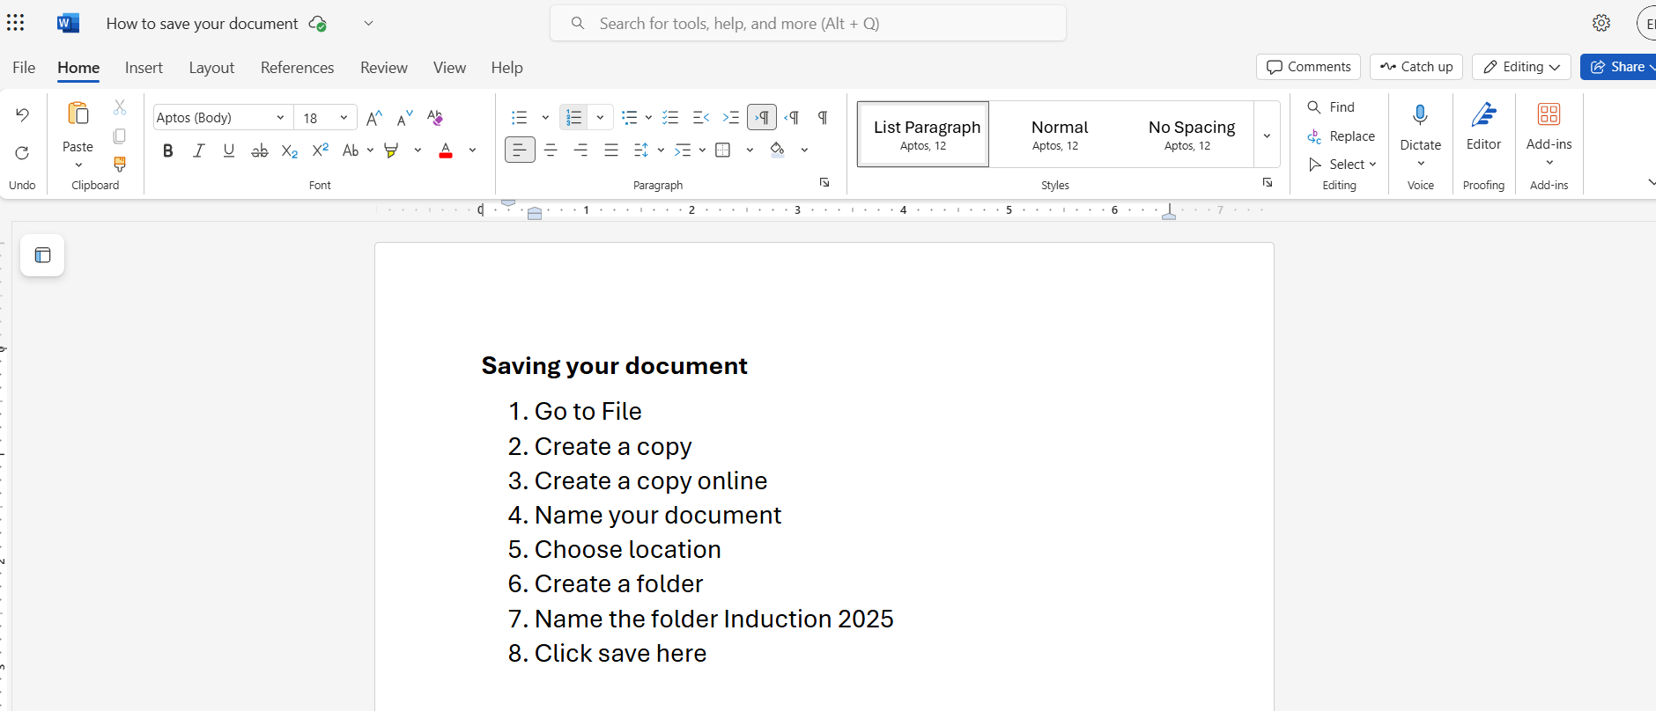
Step 3: Save your file in OneDrive
To save a file,
go to File
Follow these instructions
Menu
Next

Slide 19
Activity 3: Creating a file in Microsoft Word
Create a Word doc.
Write instructions on how to save a file.
Save this file into the Induction folder you made earlier and name it Instructions.
Menu
Next

Slide 20
4. Creating and Sending an Email in Microsoft Outlook
Add in the outlook app on the phone in order to get notification of the emails
Menu
Next

Slide 21
Step 1: Open Microsoft Outlook
Click on the Outlook Icon
Menu
Next

Slide 22
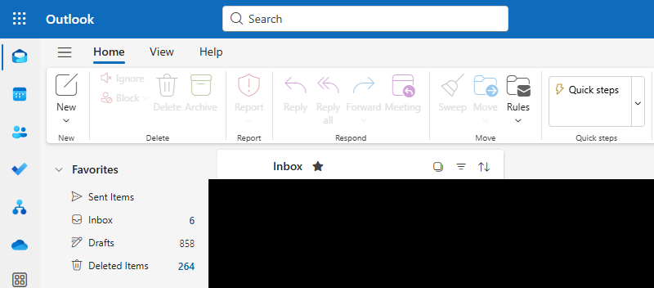
Step 2: Create an email
Click on New icon to create your email
Menu
Next

Slide 23
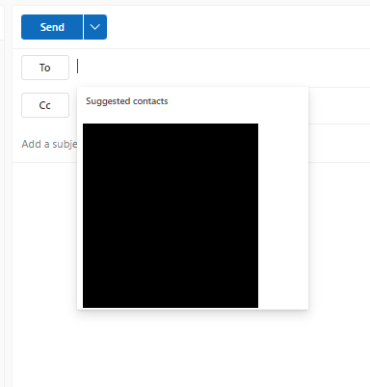
Step 3: Enter the email address
Enter the email address here
Menu
Next

Slide 24
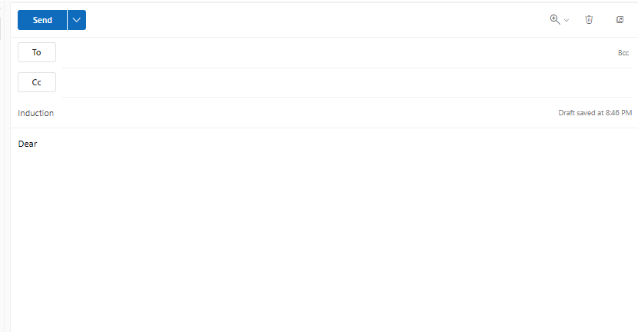
Step 4: Add title and email content
Give your email a title
And type your email here
Menu
Next

Slide 25
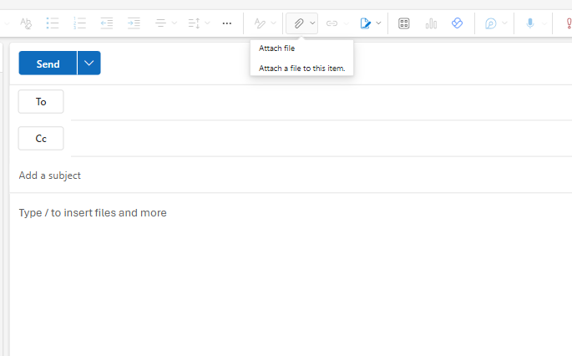
Step 5: Attach a document
Click the paperclip icon to attach a file
All assignments must be send by attaching the file to the email
No google drive and docs are allowed to be used only 365
Menu
Next

Slide 26
Step 6: Send your email
Click Send button when ready to send
Menu
Next

Slide 27
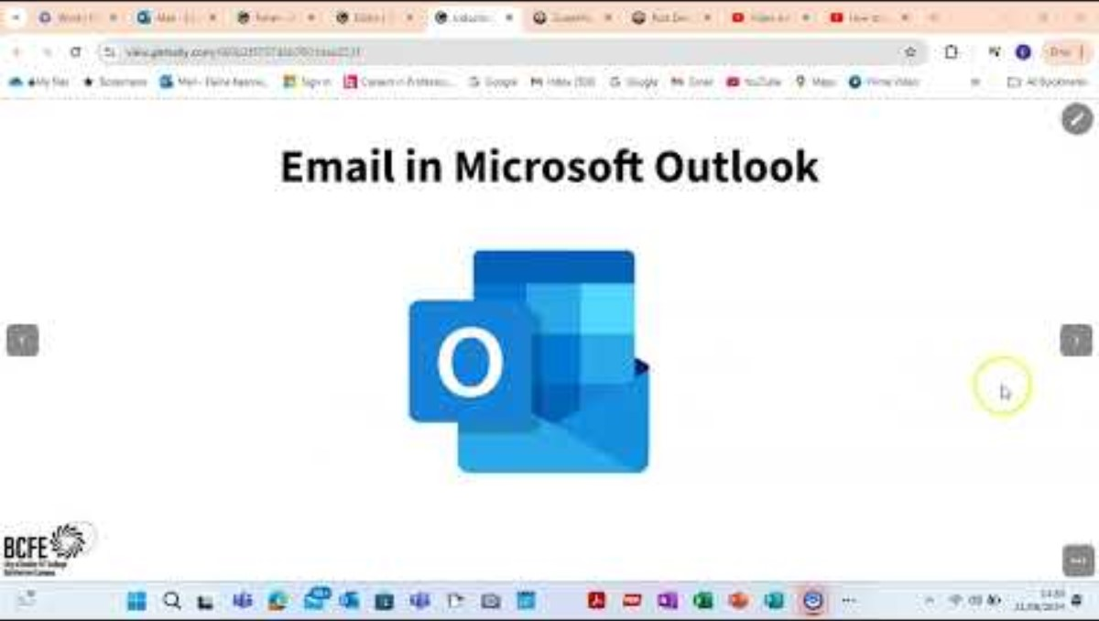
Activity 4: Send email to your coordinator
Create an email in Outlook
Type in the email address your coordinator gave you
Give the email a title / subject Induction
Attach your Instructions Word file
Send Email
Menu
Next

Slide 28

5. Accessing Teams & Moodle
Click on the each of the boxes to find out more
Menu
Next

Slide 29
Four Steps to access Teams
Menu
Next

Slide 30
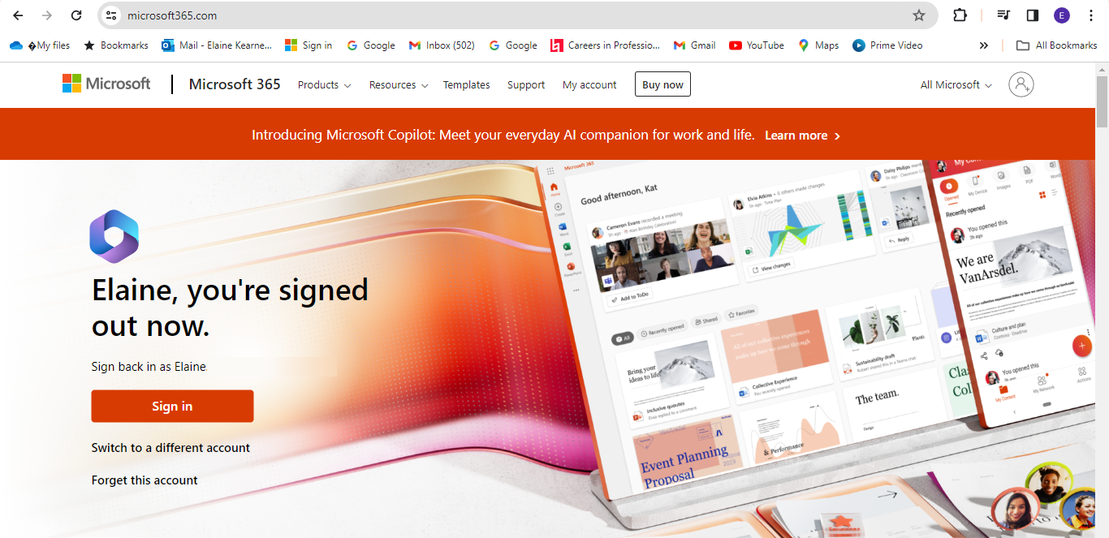
Step 1: Access Teams
Go to Microsoftoffice.com
Click on orange sign in button
Menu
Next

Slide 31
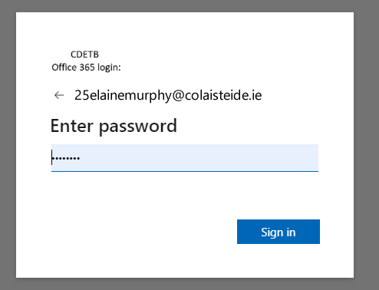
Step 2: Access Teams
Click on blue sign in button
Enter your Username (college email address) & Password
Menu
Next

Slide 32
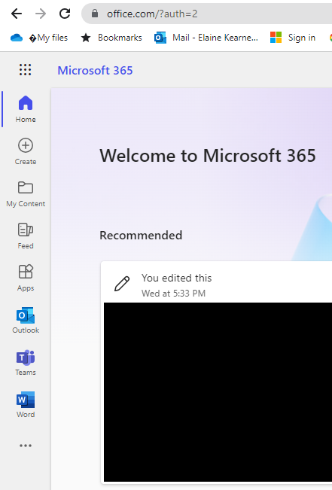
Step 3: Access Teams
Click 9-dot menu icon to find the Teams icon
Or, click on Teams icon on side bar
Menu
Next

Slide 33
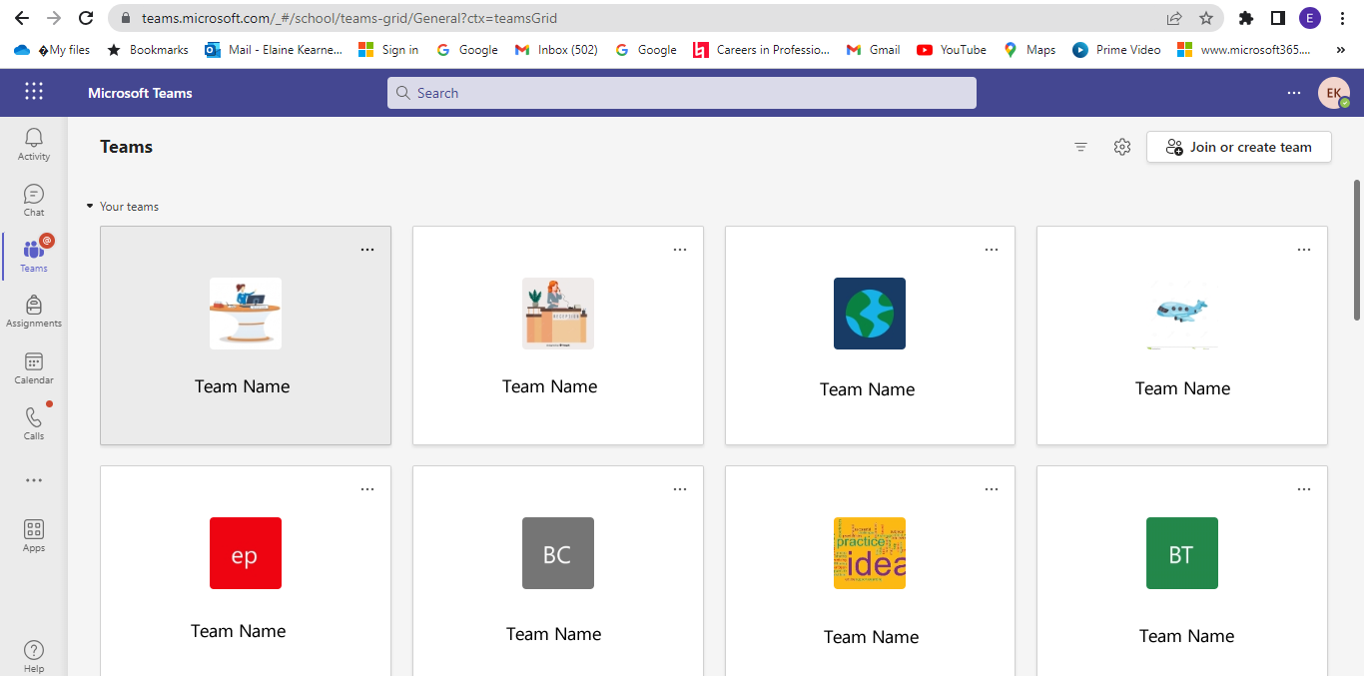
Step 4: Access Teams
You are now in Teams!
Click on the Team you wish to access.
Menu
Next

Slide 34
Four Steps to access Moodle
Menu
Next

Slide 35
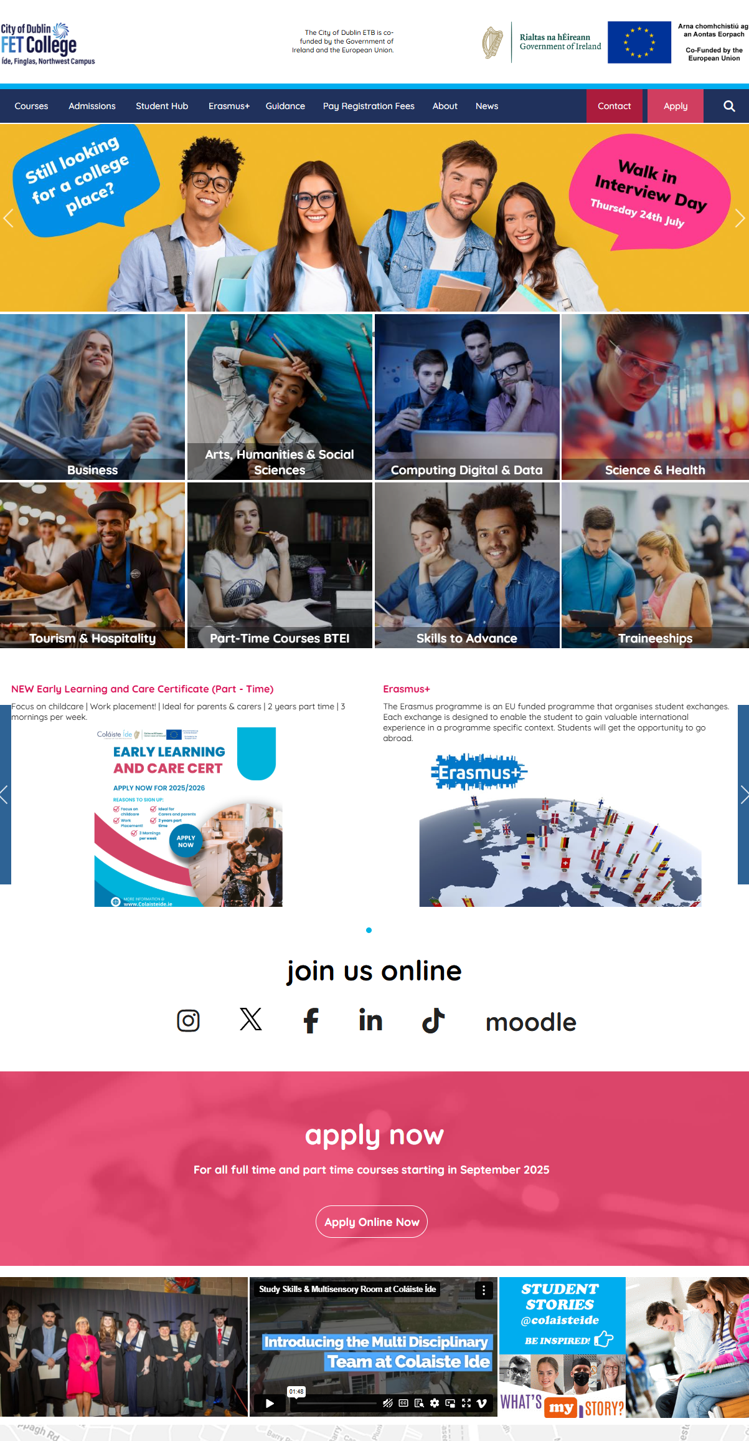
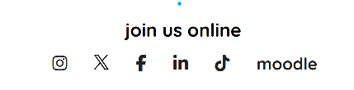
Step 1: Access Moodle
Scroll until you can see the Moodle link, and click it
Go to www.colaisteide.ie
Menu
Next

Slide 36
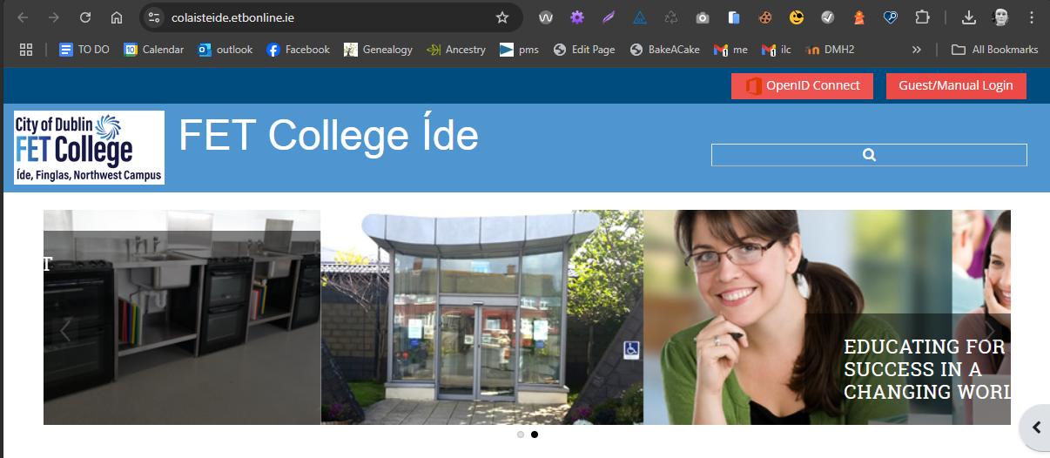
Step 2: Access Moodle
Click the red Guest / Manual Login button
Menu
Next

Slide 37
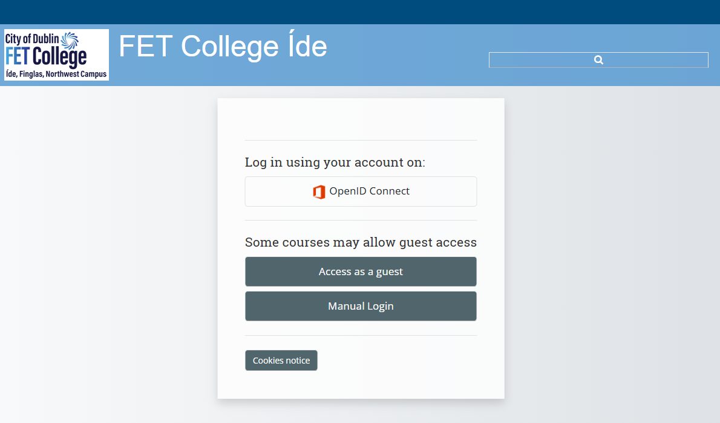
Step 3: Access Moodle
Choose the Manual Login Connect button
Username: 25NameSurname@colaisteide.ie
Password: to be provided by your teacher
Menu
Next

Slide 38
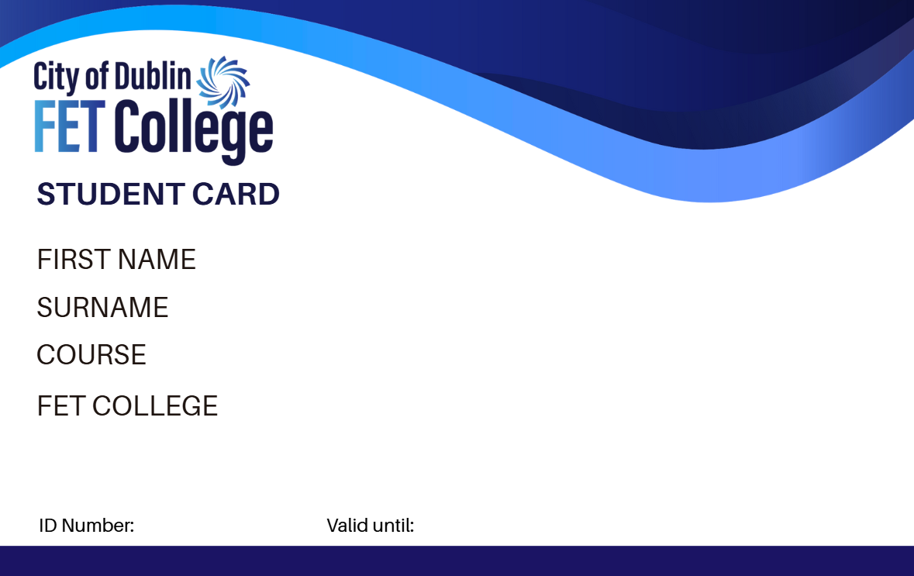
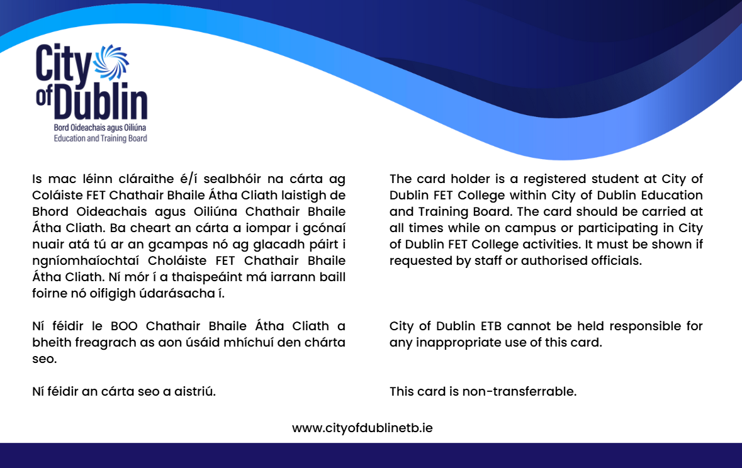
6. Getting your Student Card
Menu
Next

Slide 39
Steps for Learners
Learners will receive a link to their email address. The link is unique to each learner. They may need to be reminded to check their spam folder for the email. The learner will be prompted to upload a passport-style photo. Step by step instructions with photo guidelines are given in the email. Reminder emails will be sent to the student only if the learner has not yet uploaded their picture or if the uploaded photo does not meet the required standard. Processing and printing of the card commences, and cards are issued to each centre within 7 working days. For any student who has not uploaded a passport photo in time for the printing run, or if their photo has been rejected, their details will go forward into the next processing batch. Cards will be packaged according to their student number. *Dependent on the learner uploading a photo promptly.

Slide 40
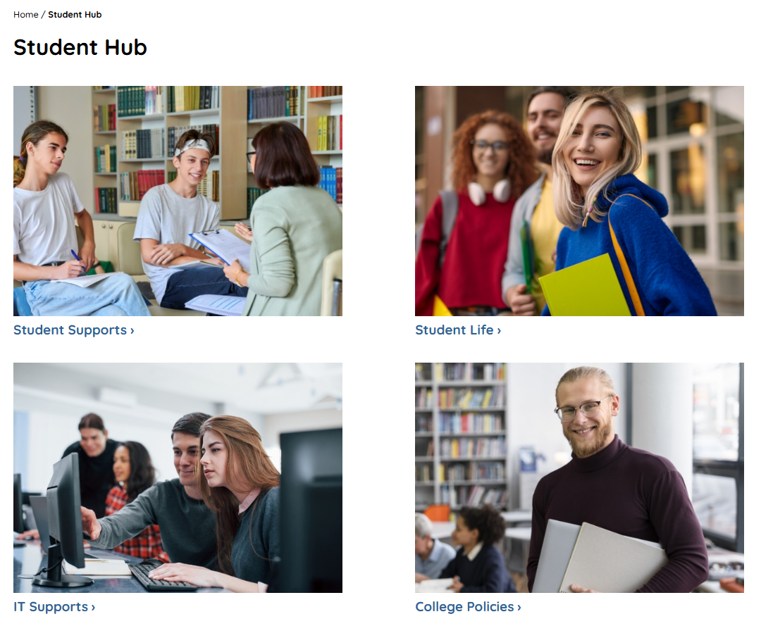
7. Student Support Hub
The Student Hub is a support hub, where you can find out all about the college.
colaisteide.ie/student-hub
Menu
Next

Slide 41

ICDL AI Course
Learn about AI in Industry.
For further information please
contact Open Learning Centre Manager
Email: fergus.orourke@ide.cdetb.ie
Menu
Next

